Slide 1
A/B testing
By Zhanna Kozlova

Slide 2

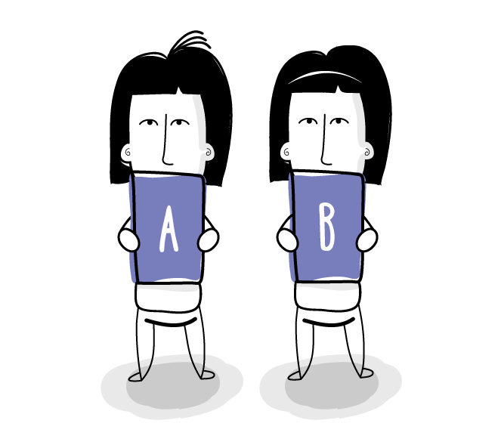

A/B testing
A/B testing is the process of comparing two variations of a page element, usually by testing users' response to variant A vs variant B, and concluding which of the two variants is more effective.

Slide 3
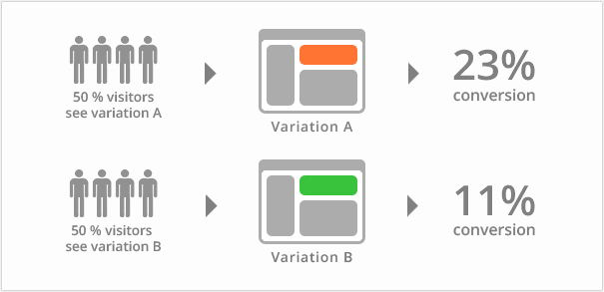
Why should I conduct “ A/B testing?”
A/B testing of landing pages can generate up to 30-40%
more leads for B2B sites;
20-25% more leads for eCommerce sites;
Only 40% of marketers validate test results.

Slide 4
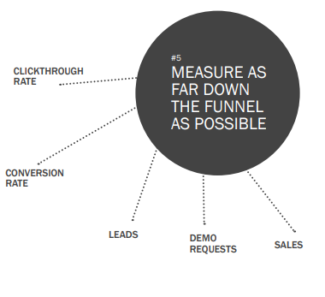
Guidelines for effective A/B Testing
#1 Only conduct one test at a time
#2 Test one variable at a time
#3 Test minor changes, too
#4 Measure as far down the funnel as possible

Slide 5
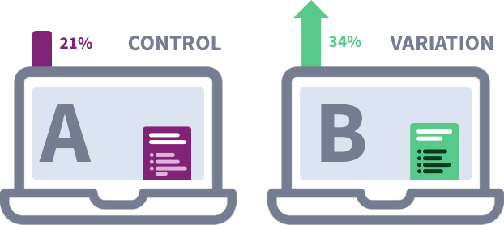
Guidelines for effective A/B Testing
#5 Set up control & treatment
• Variation A:
Control (the unaltered, original version)
• Variation B: Treatment (the optimized version which you expect to perform better)

Slide 6
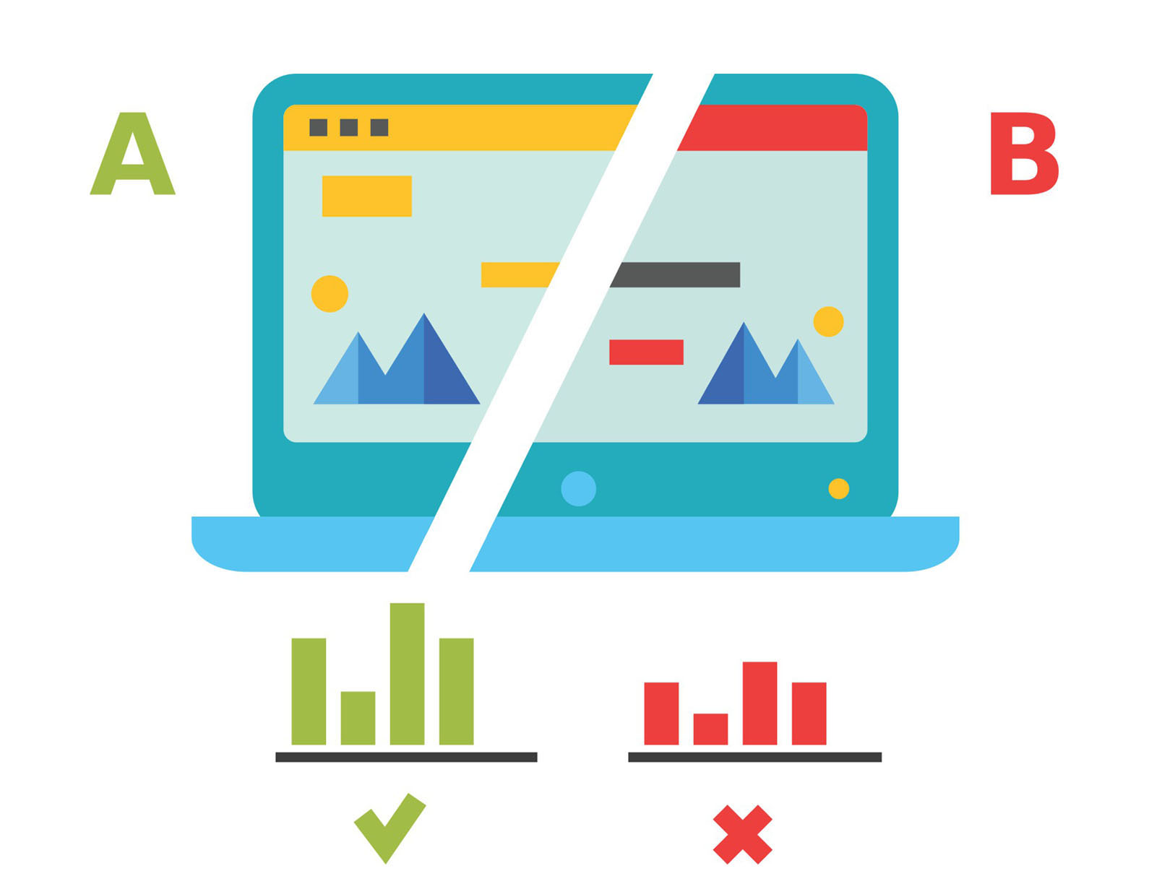
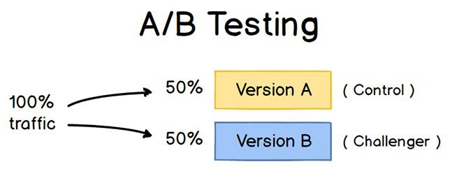
Guidelines for effective A/B Testing
#6 Decide what you want to test
#7 Split your sample group randomly
#8 Test at the same time

Slide 7
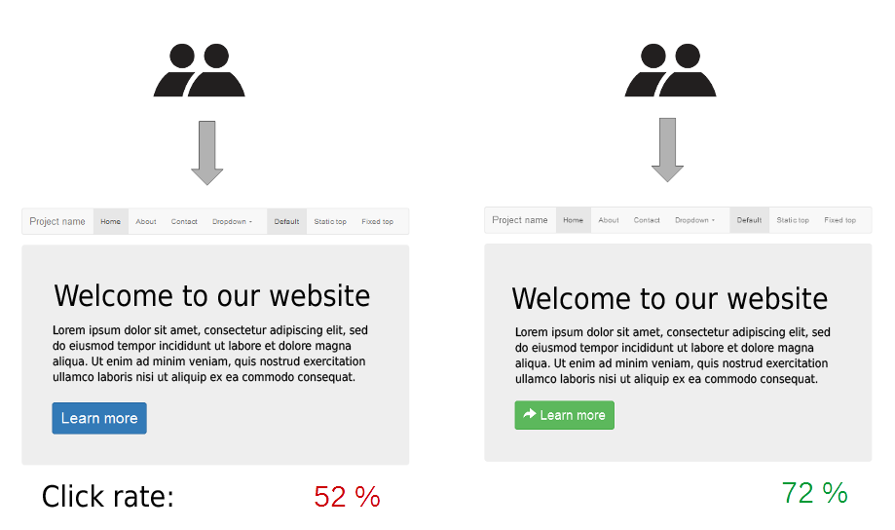
What Variables you should test
Landing pages:
OFFERS:
What types of offers convert the most visitors into leads and which offers help you push leads down the sales funnel?

Slide 8
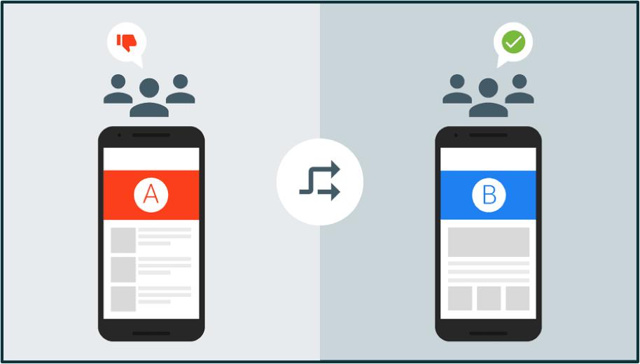
What Variables you should test
Landing pages:
TOPICS/COPY:
How should you position your offer? What messaging will entice your reader? Should you add testimonials to strengthen the visitor’s incentive?

Slide 9
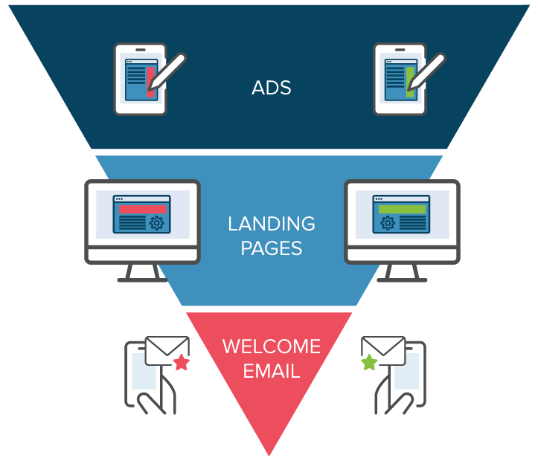
What Variables you should test
Landing pages:
FORM FIELDS:
Should your lead capture form only request an email address or should it ask for more information?
WHOLE PAGE

Slide 10

What Variables you should test
Call to action
PLACEMENT
According to an Eyetrack III study, the best placement of online ads is in the top and left position.
Copywriter Dean Rieck suggests that once your readers get used to a particular placement, they might start ignoring the call-to-action or ad.

Slide 11
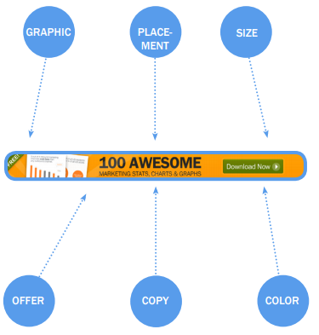
What Variables you should test
Call to action
SIZE
Create an A/B test to see if a big call to-action that adds value to the message.
COLOR
COPY
GRAPHIC

Slide 12
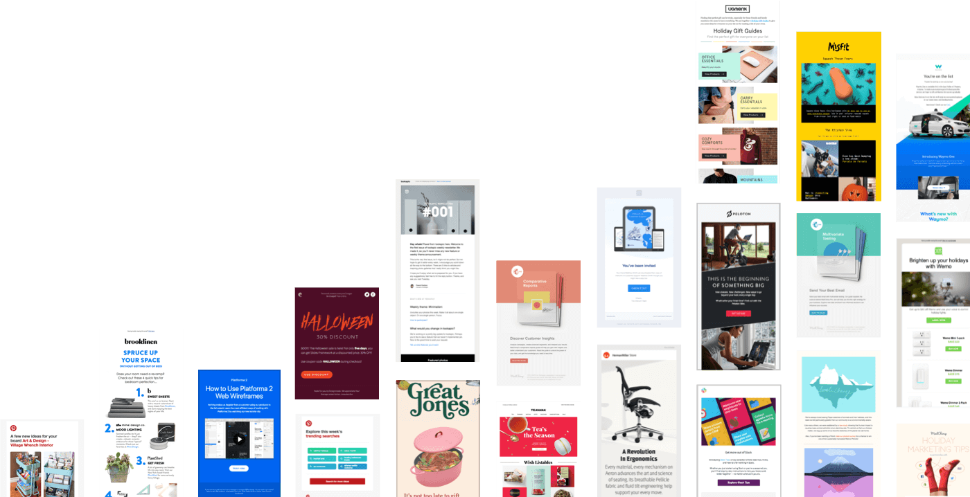
Elements that you can optimize in your email:
FORMAT
LAYOUT
SENDER
SUBJECT LINE

Slide 13
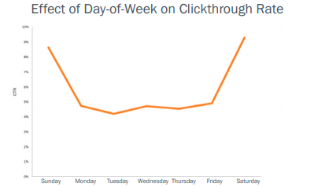
What Variables you should test
TIMING

Slide 14
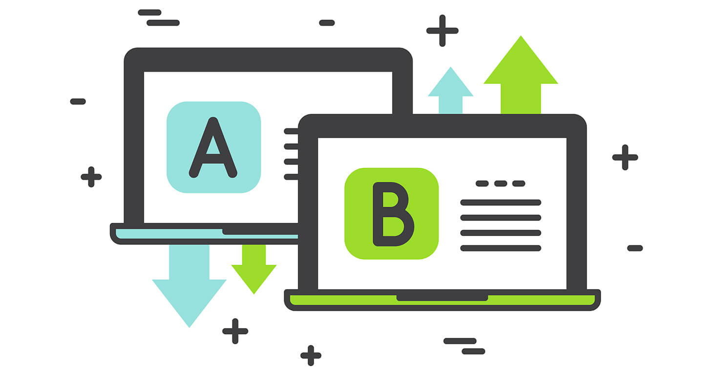
Elements you shouldn’t bother testing:
Minor Text Changes
General Improvements

